Slide 1
Infrastructure & Database Monitoring
Vikash Verma

Slide 2
What is Infrastructure Monitoring?
Infrastructure monitoring tracks:
CPU utilization
Memory consumption
Disk I/O
Network traffic
Process health
Container health

Slide 3
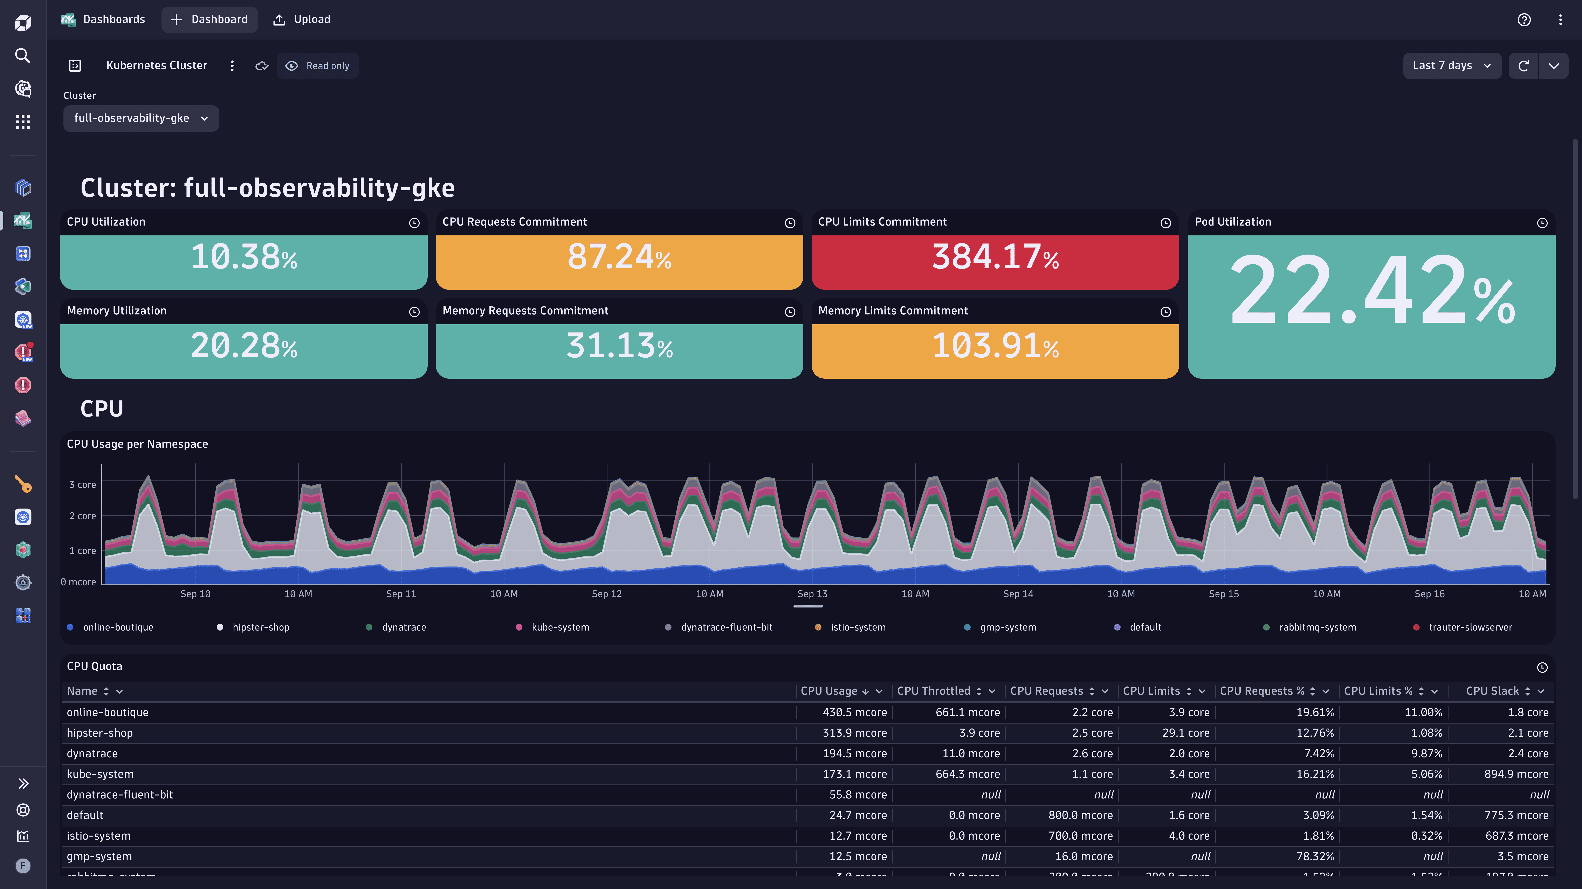
Dynatrace Infrastructure Monitoring

Slide 4
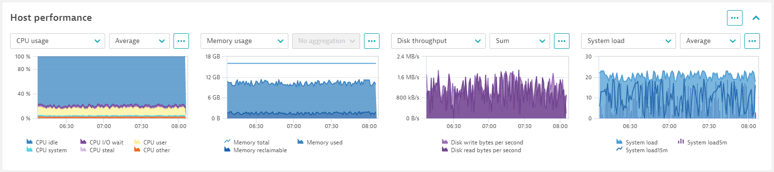

Slide 5
Dynatrace Infrastructure Monitoring
Dynatrace automatically monitors:
Hosts (VM, EC2, On-prem)
Kubernetes nodes
Containers
Processes
OS-level metrics

Slide 6
Host Monitoring Deep Dive
In Dynatrace → Infrastructure → Hosts
Key Metrics:
CPU %
Load average
Memory usage
Disk queue length
Network throughput

Slide 7
Process-Level Monitoring
Dynatrace auto-detects:
Apache
Nginx
Node.js
.NET Core
Java
Real Scenario:
Apache consuming 90% CPU → API response delay.

Slide 8
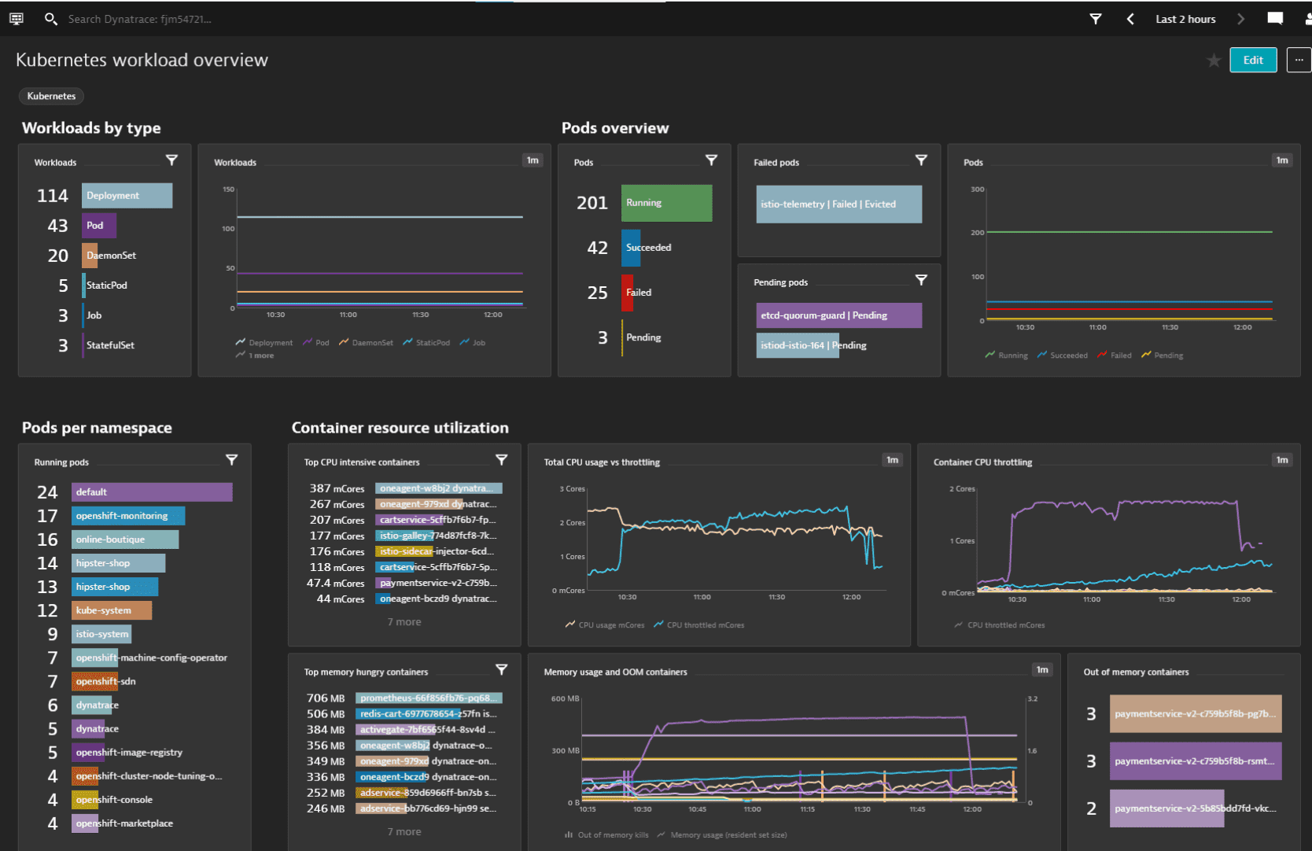
Container Monitoring (Kubernetes)

Slide 9
Container Monitoring (Kubernetes)
Metrics monitored:
Pod CPU
Pod memory
Restarts
Node health
Namespace performance

Slide 10
Network Performance Monitoring
Why Network Monitoring Matters
Even if CPU is normal:
Latency can increase
Packet loss may occur
External API slowness
Cross-region delays
Network issues often appear as:
“Application is slow” but CPU looks fine.

Slide 11
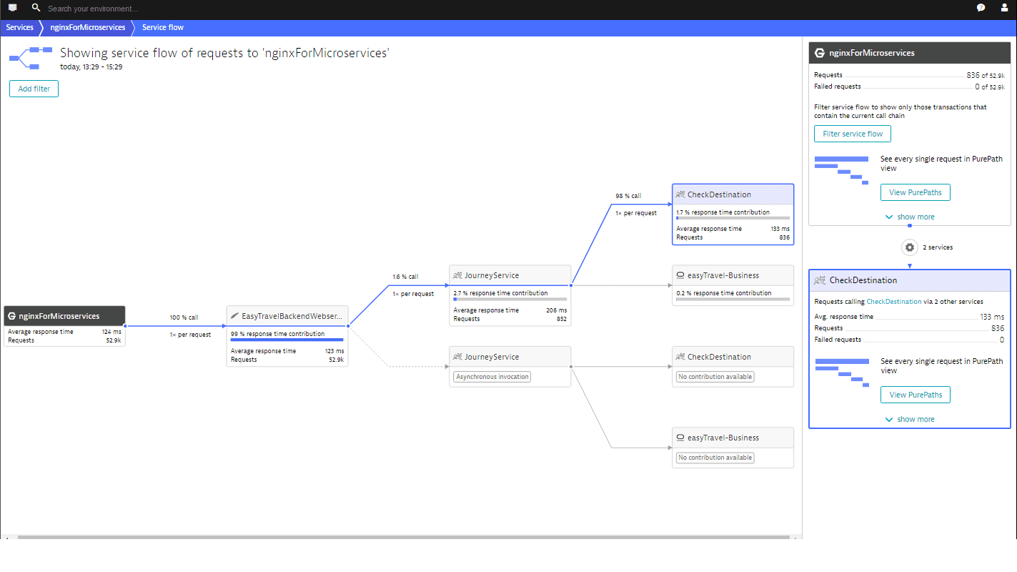
Dynatrace Service Flow View

Slide 12
Dynatrace Service Flow View
Service Flow shows:
Service-to-service calls
External dependencies
Latency between services
Failure rates

Slide 13
Network Latency Analysis
Metrics to check:
Response time breakdown
TCP connect time
SSL handshake time
Server processing time
Use PurePath to identify:
Where delay occurs
Whether issue is network or server

Slide 14
Database Monitoring
Why Database Monitoring is Critical
Most performance issues come from:
Slow queries
Lock contention
Missing indexes
Connection pool exhaustion

Slide 15
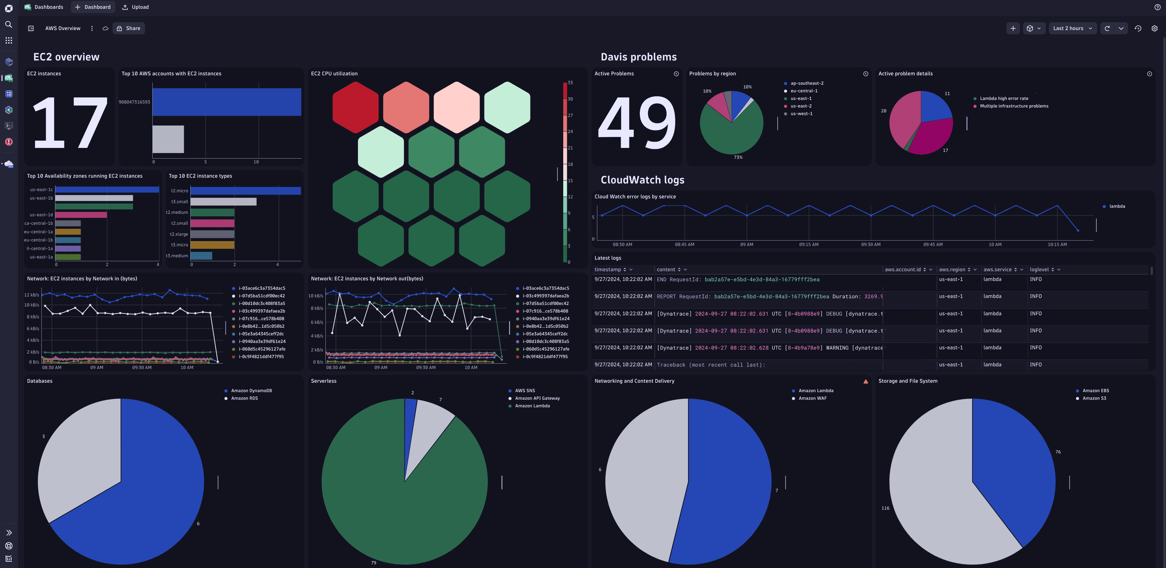
Dynatrace Database Monitoring

Slide 16
Dynatrace Database Monitoring
Supported Databases:
MySQL
PostgreSQL
SQL Server
Oracle
SQLite
MongoDB
Dynatrace auto-detects DB calls via OneAgent.

Slide 17
Database Metrics to Monitor
Key metrics:
Query execution time
Calls per minute
Failure rate
Connection usage
Lock waits
Deadlocks

Slide 18
Query-Level Analysis
What is Query-Level Monitoring?
Dynatrace captures:
Exact SQL statement
Execution time
Bind parameters
Frequency
Impacted services

Slide 19
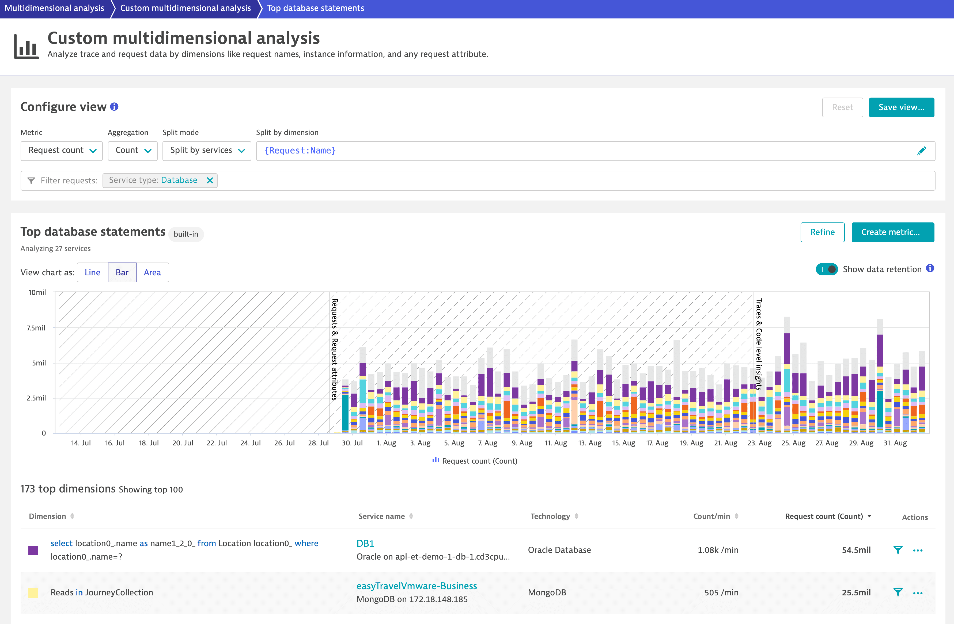
Query-Level Analysis

Slide 20
Query Analysis View
You can:
Sort by execution time
Sort by failure rate
Identify N+1 queries
Detect missing indexes

Slide 21
Microservices Bottleneck Detection
What is a Bottleneck?
A bottleneck is:
The slowest component limiting overall performance.
Could be:
CPU
Network
Database
External API
Thread pool

Slide 22
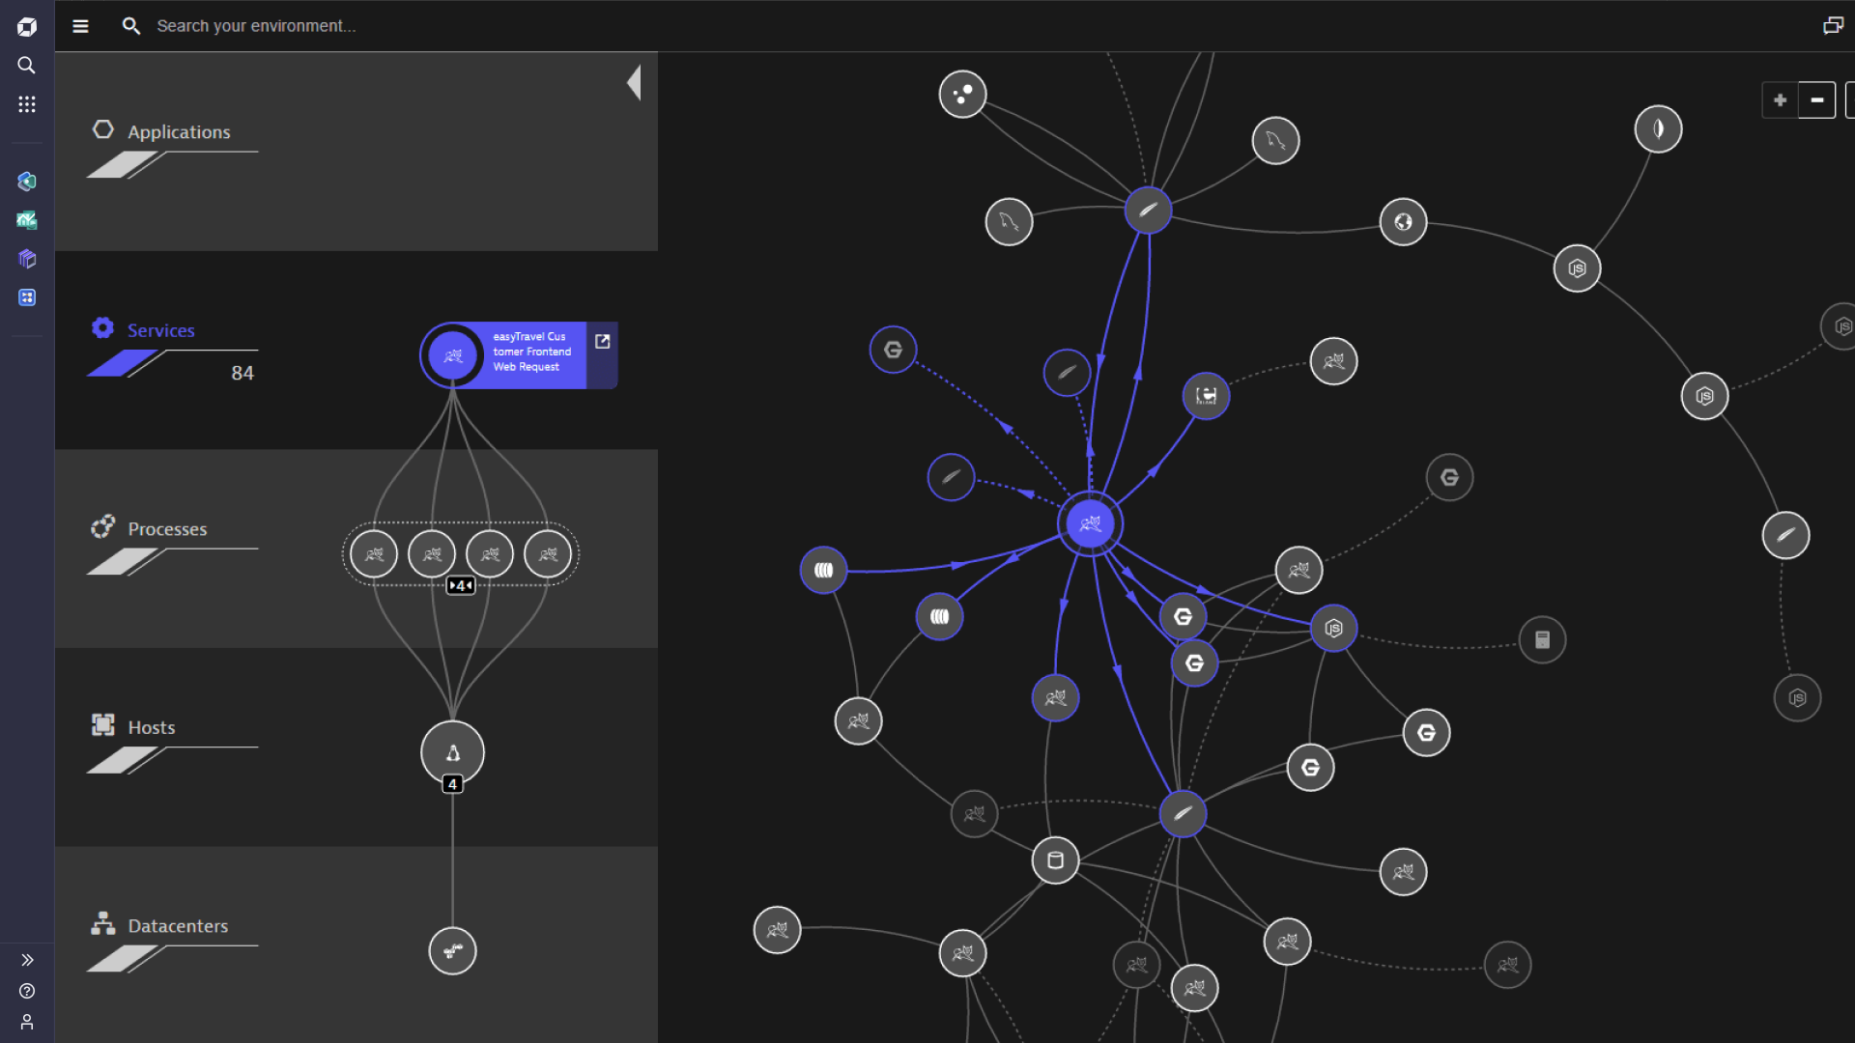
Smartscape Topology

Slide 23
Smartscape Topology
Smartscape shows:
Hosts
Processes
Services
Databases
Dependencies
It automatically identifies:
Root cause
Impacted services
User impact

